Slide 1
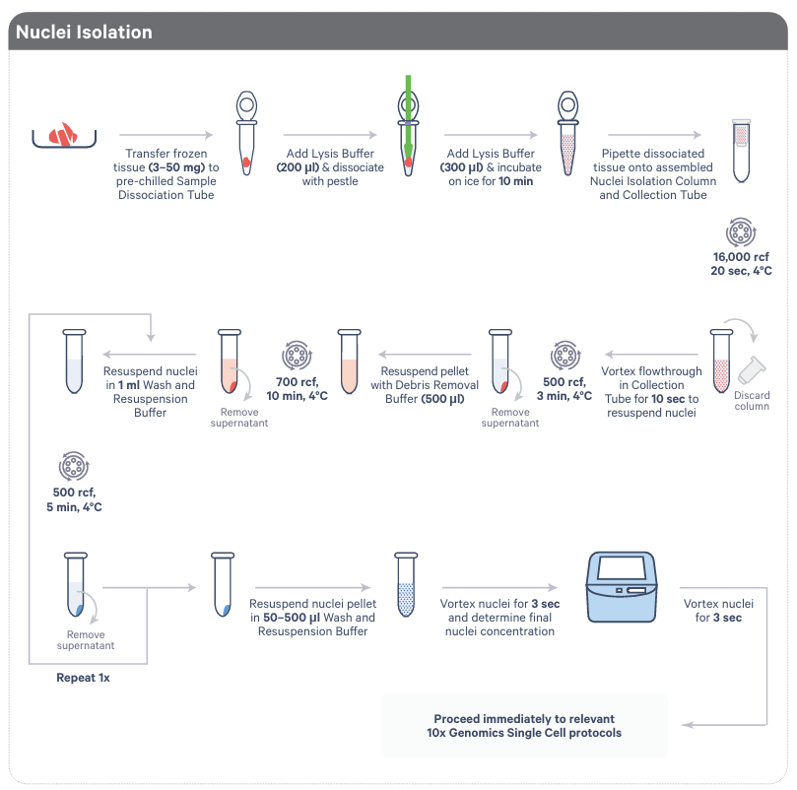
5 Twists
5 Assembloids
flash-frozen in
dissociation tube
100µL
100µL
Transfer solution
to a round bottom
FACS tube
500µL
Swinging Bucket
Centrifuge
100µL
2µL Sample + 18µL
Trypan Blue

